Slide 1


PageRank Algorithm

Slide 2
Team Members:
Ahmed Sherif Abdel Hamid Tarfa – 20221321942
Robert Nagi Raafat - 20221445710
Brief overview of PageRank algorithm:
Developed by Larry Page and Sergey Brin at Google in 1996 as part of their research project at Stanford University.
Originally named "Backrub," it was later renamed PageRank in honor of Larry Page.
PageRank measures the importance of web pages by analyzing the structure of hyperlinks between pages.

Slide 3
Code Overview
Main Function:
This is the starting point of our code. Think of it as the traffic controller directing the flow of our program.
Purpose:
It manages the whole process, from receiving instructions to showing the final results
What it Does:
Handles the information we give it when we run the program, like where to find the web pages to analyze.
Starts the process of going through each web page and figuring out how they're connected.
Calculates the PageRank using two different methods: one where we randomly jump from page to page, and another where we calculate it based on the connections between pages.
Finally, it shows us the results.
Required Information: When we run our program, we need to give it one important thing: the location of the folder where all the web pages are stored. We call this folder the "corpus."

Slide 4
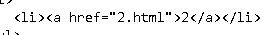
Crawling HTML Pages
What's Happening:
The crawl function looks through a bunch of web pages saved in a folder (we call this the "corpus") and finds all the links on each page.
How it Works:
It creates a list for each page, showing which other pages it links to.
Getting Links:
To find the links, it uses a special tool called regular expressions to look for certain patterns in the web page code, specifically the <a> tags with href attributes.
Removing Loops:
If a page links to itself, we don't want to count that, so we make sure to remove any self-referencing links.

Slide 5
Transition Model
What it Does:
The transition_model function decides which page to visit next when we're moving around the web.
How it Decides:
It uses a trick called a "probability distribution" to decide. This means it looks at both where we can go from our current page and where we might randomly jump to.
Choosing Next Page:
Sometimes, we follow a link from the current page. Other times, we just jump to a random page in the whole collection (the "corpus"). This helps us explore different parts of the web.

Slide 6
Sampling PageRank
What it Does:
The sample_pagerank function guesses the importance of each web page by pretending to be a person randomly clicking links.
How it Works:
It starts at a random page and takes a certain number of steps, randomly clicking links along the way.
Counting Visits:
Every time it lands on a page, it keeps track of how many times it's been there.
Finding Importance:
The more times a page gets visited, the more important it seems. So, we use this to figure out each page's "PageRank."

Slide 7
Iterative PageRank
What it Does:
The iterate_pagerank function calculates the importance of each page by continuously updating their scores until they stop changing much.
How it Works:
It starts with an equal score for every page. Then, it keeps adjusting the scores based on the links between pages.
Keep Adjusting: It does this over and over until the scores stop changing much, meaning they've settled down.
Accuracy and Stability: This method helps us get more accurate and stable results, especially for larger and more complex web networks.

Slide 8
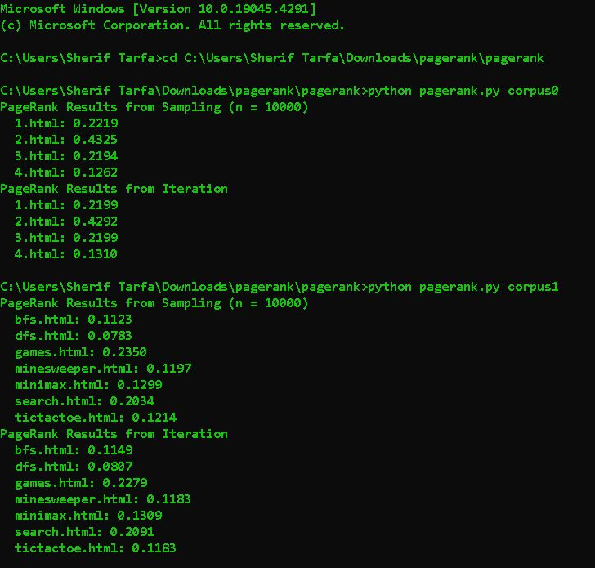
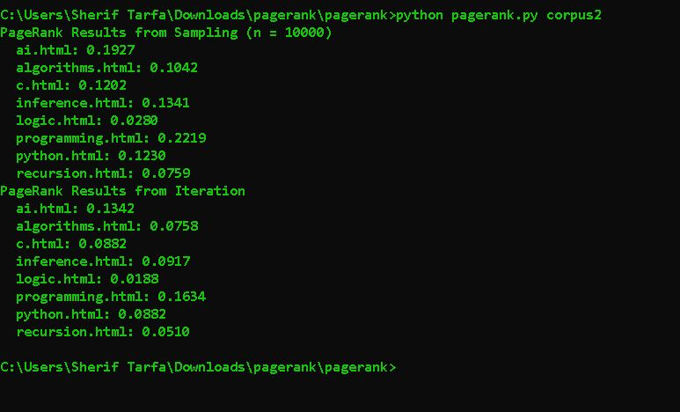
Results
What we Found:
We looked at PageRank results using both random sampling and iterative methods.
Sample Results:
We show some example PageRank values for a small group of web pages.
Comparing Methods: We compare the results from both methods to see how they differ.
Why it Matters: Understanding these differences helps us see how accurate and reliable our PageRank calculations are, especially when dealing with big collections of web pages.

